Slide 1

QUESTION ANSWERING CHATBOT USING RAG
Portfolio Project
BY:
Jayakrishna Reddy Puttur

Slide 2



Goal: To build an abstractive QA chatbot using RAG.

Slide 3

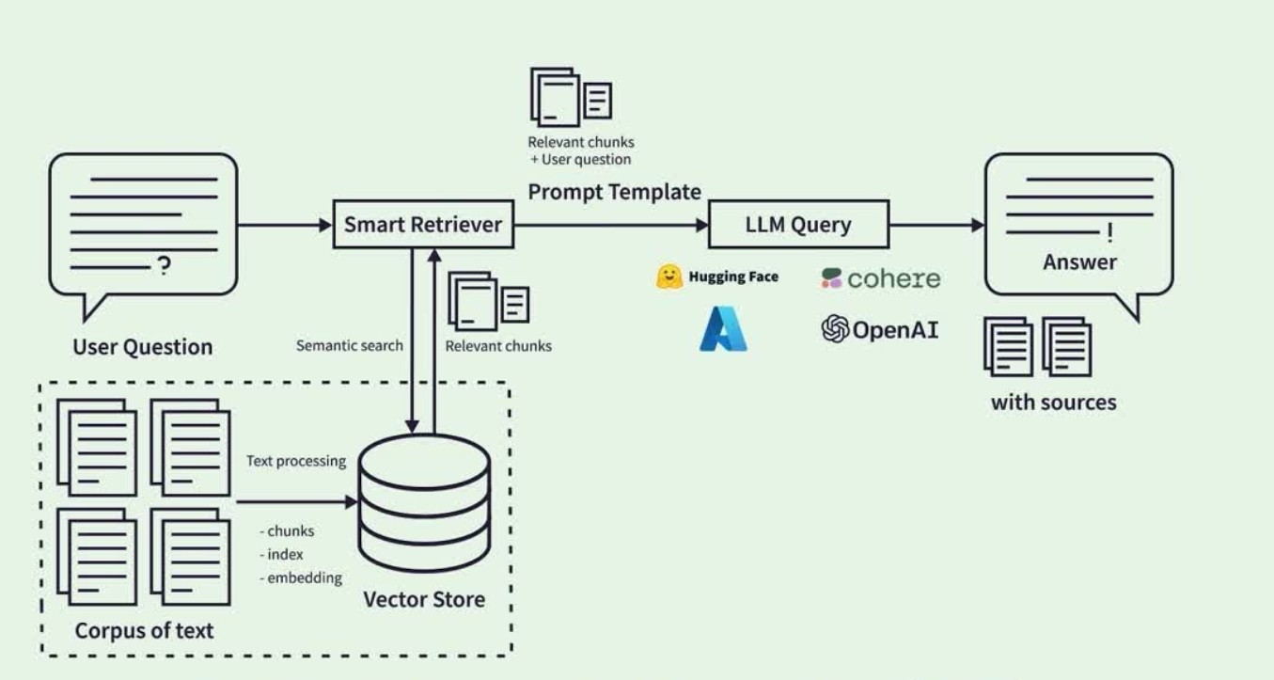
Architecture Diagram

Slide 4
RAG Pipeline
I. Indexing: ingesting data from a source and indexing it.
Document Loaders: Load different types of documents like text file, pdf file etc.
Text Splitters: Breaks large documents into smaller chunks to fit in a model’s finite context window.
Text Embedding Models: Converts chunks into embeddings using different methods like cohere, huggingface and OpenAI embeddings.
Vector Stores: To store and index the split embeddings, so they can be later searched over. Used Faiss and Chromadb.

Slide 5
RAG Pipeline
II. Retrieval and generation:
1. Retrievers: Given a user input, relevant splits are retrieved from storage using a retriever. It accepts a string query and returns a list of documents as output.
Examples:
●
Vector store, Contextual Compression retriever, Multi-query retriever, Parent Document retriever, Ensemble retrievers.
●
RAGatouille (uses ColBERT), Cohere and Cross Encoder rerankers.
2. Generation: A RAG chain produces an answer using a prompt that includes the answer and the retrieved data.

Slide 6
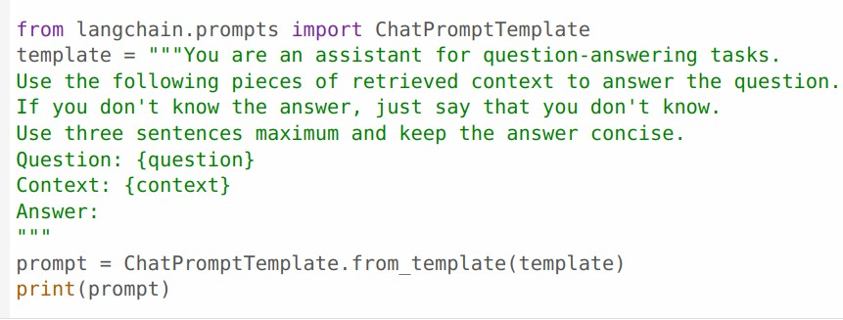
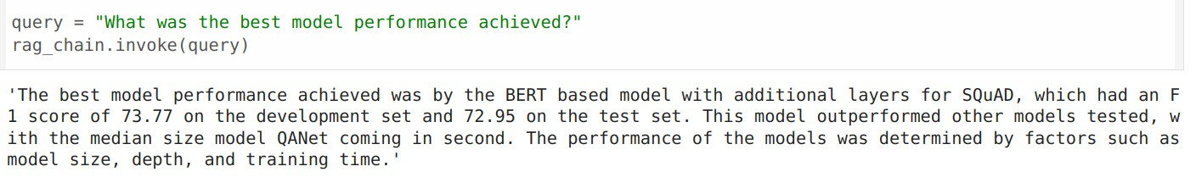
Basic RAG Pipeline
●
Input document: Bert research paper, 16pgs
Embedding model: miniLM (open source) Vector store: FAISS
LLM: OpenAI gpt-3.5-turbo, temperature = 0 Retriever: vector store backed retriever – Faiss
Created a prompt and a rag chain and generated results.
●
●
●
●
●

Slide 7
Datasets for Evaluation
To evaluate embeddings: STS benchmark dataset, the Semantic Textual Similarity dataset. It contains pair of sentences and a human annotated score that gave the similarity between them.
To evaluate the retrievers and their respective RAG pipelines: used a subset of dataset from the paper, “ ARAGOG: Advanced RAG Output Grading”, April 2024. From the original set of 107 samples, only 8 samples were used for evaluating. This was the gold dataset, which had questions and ground truths that was generated using GPT-4 in the original paper. Only one input document was used, owing to limited compute.

Slide 8

●
OpenAI Embeddings, default ada model, 1536 dim
Cohere Embeddings, embed-english-light-v3.0, 384 dim HuggingFace Embeddings, BAAI/bge-base-en-v1.5, 768 dim
Sentence Transformers MiniLM Embeddings, all-MiniLM-L6-v2, 384 dim
Matroyshka Embeddings, tomaarsen/mpnet-base-nli-matryoshka, 768 dim
●
●
●
●

Slide 9
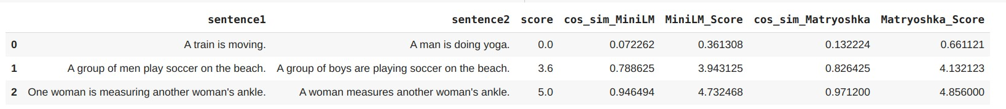
Embedding Models Evaluation
●
5 pairs of sentences were selected from the STS dataset, and cosine similarity was computed. It was transformed to [0,5] range in accordance to the STS dataset. Similarly scores were calculated for all other embedding models.
●
Evaluation metrics:
Pearson correlation measures the linear correlation between two variables.
Spearman correlation measures the strength and direction of association between the ranked values of two variables. It assesses how well the relationship between two variables can be described using a monotonic function.
Mean Squared Error is a measure of the average squared difference between the actual values and the predicted values.
●
●
●

Slide 10
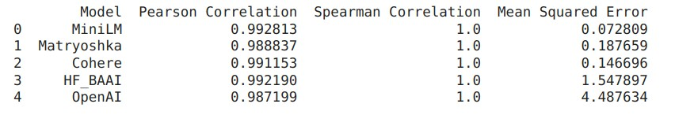

Embedding models Evaluation Results
●
All models exhibit strong correlations with the human-annotated scores, suggesting that they capture semantic similarity effectively.
●
The high Spearman correlation coefficients indicate that the models rank the sentence pairs in the same order as humans, demonstrating robustness in capturing relative similarities.
●
MiniLM performs the best overall, showing the highest Pearson correlation and the lowest MSE.
●
Cohere and HF_BAAI also perform well, with high correlation coefficients and relatively low MSE values.
●
OpenAI lags behind the other models, with the highest MSE, indicating less precise prediction of similarity scores.

Slide 11
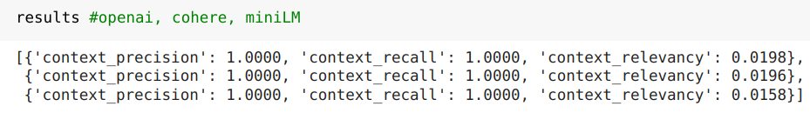
Embedding models Evaluation using Ragas
●
Context Precision and Recall: All three models, OpenAI, Cohere, and miniLM, have achieved perfect scores of 1.0000 in both context precision and recall.
●
This indicates that they are exceptionally effective in selecting highly relevant context for the questions and are also successful in capturing all necessary information from the context that appears in the ground truth answers.
●
Relevancy: The slightly higher relevancy scores for OpenAI and Cohere compared to miniLM could imply a marginal advantage in handling broader or more complex contextual relevancies.

Slide 12
Advanced RAG
Vector store-backed retriever: Basic retriever, works on MMR.
Parent document retriever: Improving a retriever by embedding our documents into small chunks, and then retrieve a significant amount of additional context that "surrounds" the found context.
Prompt Tuning - Multi Query retriever: It automates the process of prompt tuning by using an LLM to generate multiple queries from different perspectives for a given user input query.
Ensemble BM25 retriever: Given a user query, it retrieves documents from the dense vector retrieval and the sparse BM25 vector retrieval and using Reciprocal Rank Fusion, fuses and weights them into a single retrieved list.
Contextual Compression: Instead of immediately returning retrieved documents as-is, we compress them using the context of the given query, so that only the relevant information is returned.

Slide 13
Advanced RAG
ColBERT retriever: ColBERT is a fast and accurate retrieval model, enabling scalable BERT- based search over large text collections in tens of milliseconds.
Cohere reranker: After the base retriever retrieves the top 20 relevant documents, there might be lots of irrelevant texts retrieved too so the reranker ranks it by keeping the most relevant documents at the top.
Multi Query + Cohere reranker: Kept Multi Query retriever as base retriever and perfomed reranking using cohere reranker.
Cross Encoder reranker: the retrieval system might retrieve documents that are not that relevant for the search query. Hence, we use a re-ranker based on a cross-encoder that scores the relevancy of all candidates for the given search query.

Slide 14
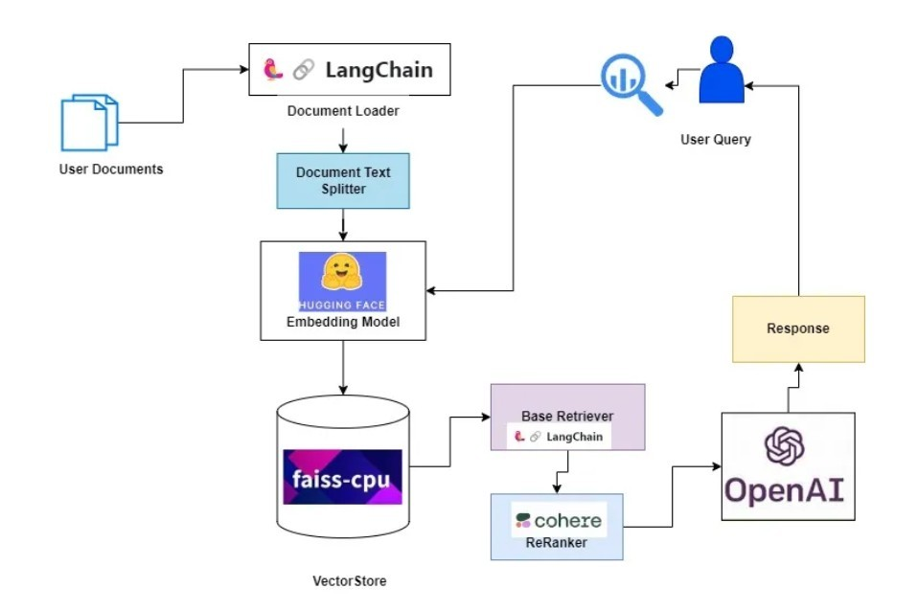
Reranker
●
Source: https://medium.aiplanet.com/advanced- rag-cohere-re-ranker-99acc941601c
Chroma DB

Slide 15
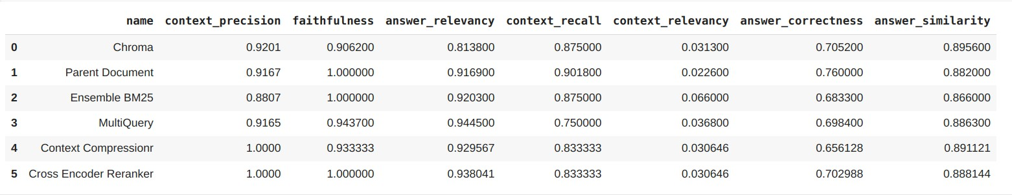
Retrievers Evaluation Results
●
Context Precision: Both Context Compression Retriever and Cross Encoder Reranker score a perfect approximate value of 1.0, indicating that they excel at selecting highly relevant context for the questions.
●
Context Recall: Parent Document Retriever scores the highest in context recall at approximately 0.902, which indicates it is particularly good at including context that contains information present in the ground truth answers.
●
Context Relevancy: It implies that the context being retrieved, while comprehensive (high context recall) is not always relevant to the query. Ensemble BM25 scores the highest.

Slide 16
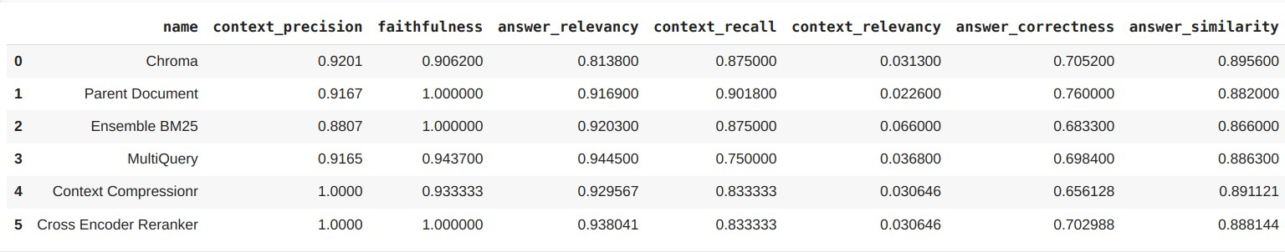
Generation Evaluation Results
●
Answer relevancy: MultiQuery Retriever leads in answer relevancy with a score of about 0.944, indicating that it provides the most relevant and complete answers in relation to the questions.
●
Faithfulness: Parent Document Retriever, Ensemble BM25 Retriever, and Cross Encoder Retriever score a perfect 1.0 in faithfulness, indicating that the contexts provided by these models are completely factual and support the answers derived from them.
●
Answer Correctness: Parent Document Retriever leads with a score of approximately 0.76, suggesting it is most effective at providing factually correct and semantically aligned answers with the ground truth.

Slide 17
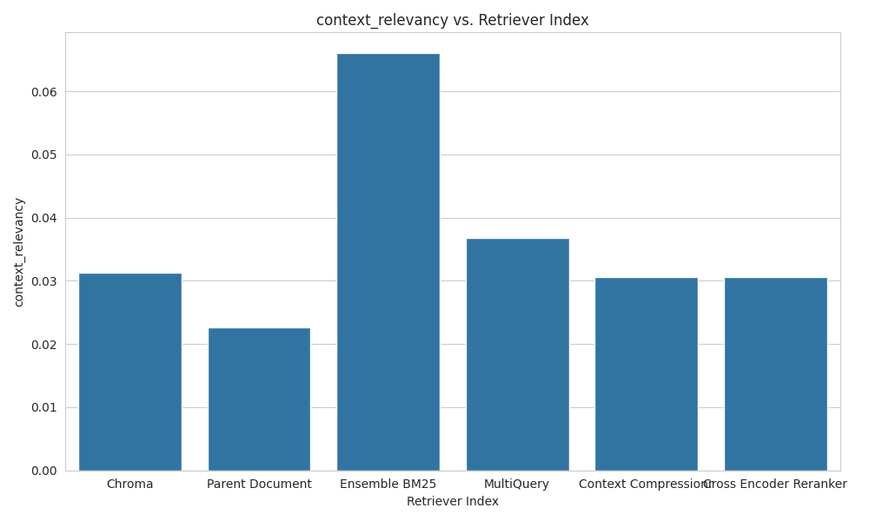
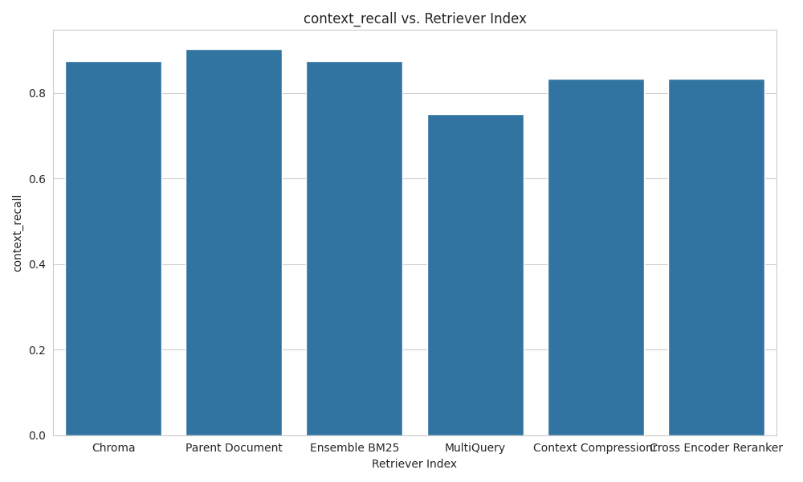
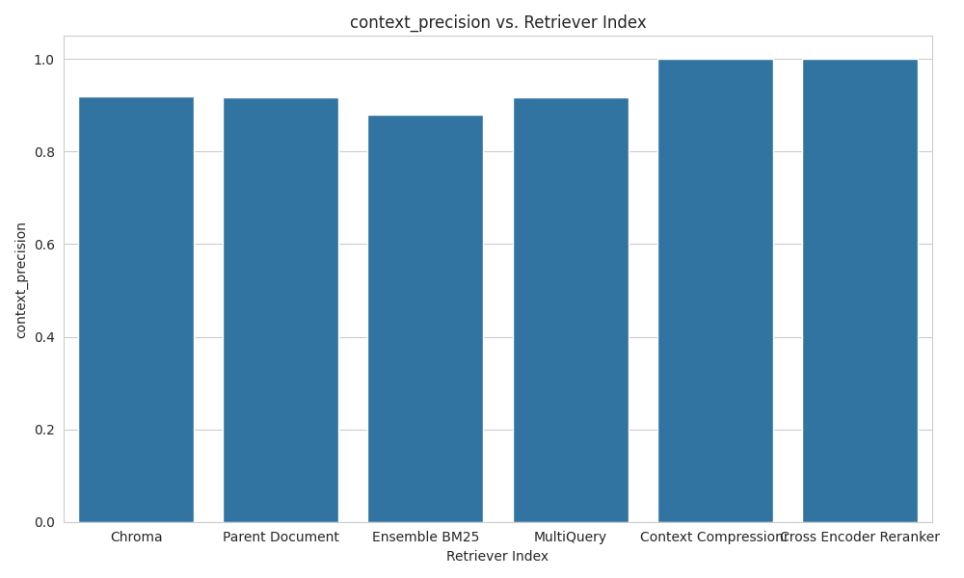
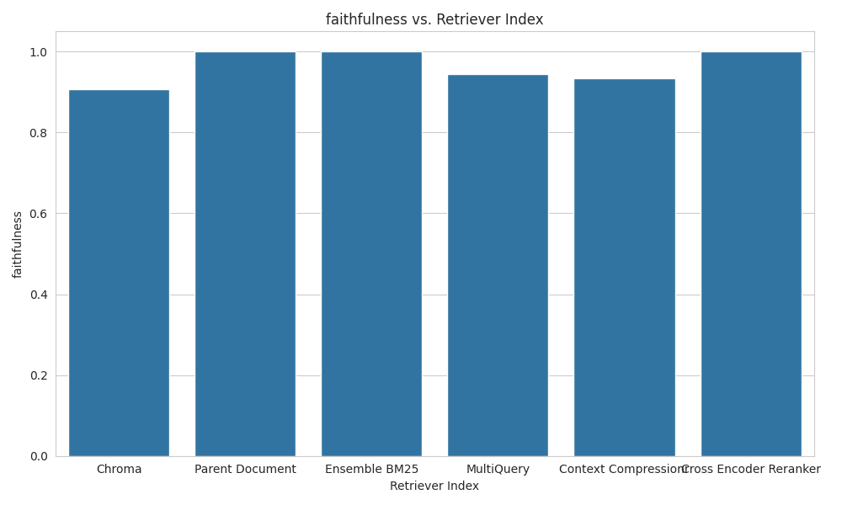
Results

Slide 18
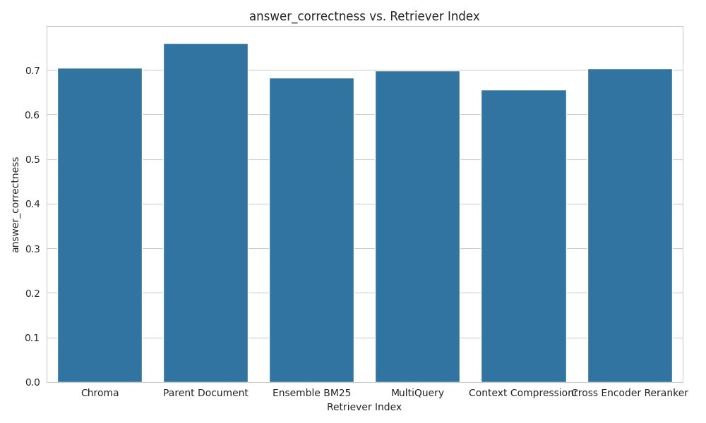
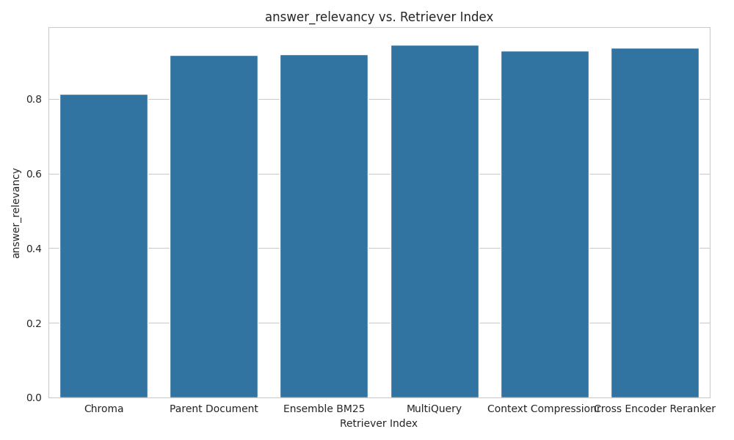
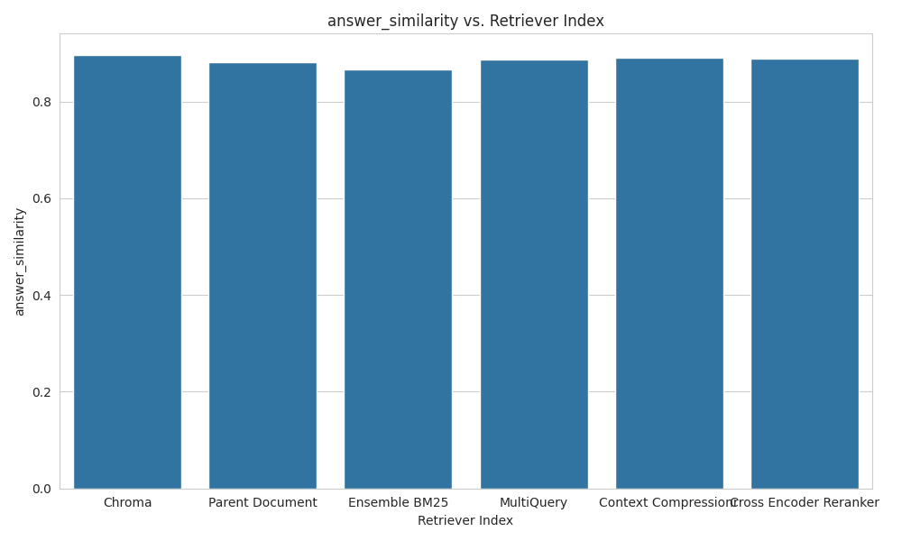
Results

Slide 19
References
Relevance-guided Supervision for OpenQA with ColBERT, https://arxiv.org/abs/2007.00814
Precise Zero-Shot Dense Retrieval without Relevance Labels, https://arxiv.org/abs/2212.10496
ARAGOG: Advanced RAG Output Grading, https://arxiv.org/pdf/2404.01037
RAGAS: Automated Evaluation of Retrieval Augmented Generation, https://arxiv.org/pdf/2309.15217

Slide 20


THANK YOU

